Slide 1
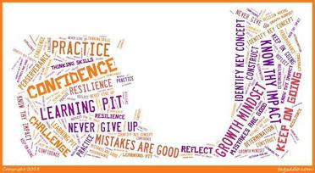
Visible Learning
- a new focus on Stjærskolen

Slide 2
Visible learning
Why use visible learning:
Important words in visible learning:
John Hatties research has shown that the most important thing to motivate pupils and to improve their laerning is to make the pupils aware of why, how and what they are going to learn.
Visible goals for each subject, period and lesson
Feedback
Visible development for every pupil
Growing mindset

Slide 3
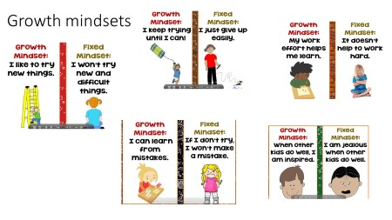
Your learning is affected by your mindset

Slide 4
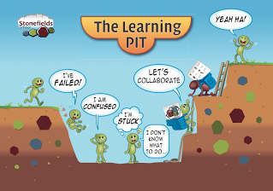
The pit – make your pupils aware of there own learning

Slide 5
Our first small steps…
Lets go to our classroom to see our first attempts towards making learning more visible to our pupils…
☺

