Slide 1

«Φεγγαράκι μου λαμπρό» Twinkle twinkle little star
Ternary form Α Β Α

Slide 2
Φεγγαράκι μου λαμπρό,
φέγγε μου να περπατώ.
Να πηγαίνω στο σχολειό,
να μαθαίνω γράμματα,
γράμματα σπουδάγματα
του Θεού τα πράγματα.
Twinkle twinkle little star,
how I wonder what you are.
Up above the world so high
like a diamond in the sky
Twinkle, twinkle little star,
how I wonder what you are!

Slide 3



Put the melody of the song in the right order!
Α
Β

Slide 4
Α
Β
Α

Slide 5
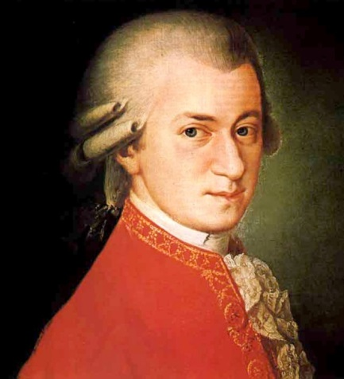

Listen to what Mozart did with the melody of “Twinkle twinkle little star”. Can you recognise the melody in the variations 2 and 6?
Theme
Variation 2
Variation 6

