Slide 1


bacon /eggs beer

Slide 2

Ham

Slide 3

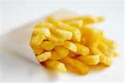
Chips water

Slide 4


Chocolate Cereal

Slide 5


Coffee salad

Slide 6


wine Milk

Slide 7


butter cake

Slide 8


Sugar olives

Slide 9
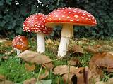
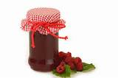
Mushrooms jam

Slide 10
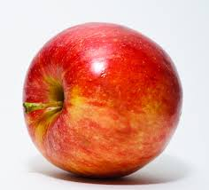

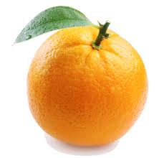
Banana orange apple

Slide 11


Train car

