Slide 1
Year 3 – Unit 11

Slide 2

Where is the mouse?
It’s on the house.

Slide 3

Where is the mouse?
It’s in the car.

Slide 4


Where is the mouse?
It’s on the train.

Slide 5

Where is the mouse?
It’s under the chair.

Slide 6

Where is the mouse?
It’s on the book.

Slide 7

Where is the mouse?
It’s on the car.

Slide 8
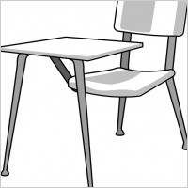
Where is the mouse?
It’s under the desk.

Slide 9
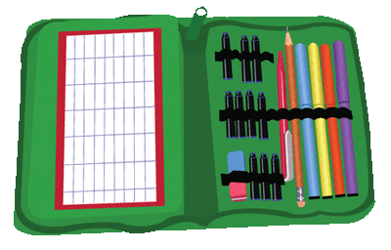
Where is the mouse?
It’s in the pencil case.

Slide 10
Presentation designed by the English Curriculum Development team, Cyprus Ministry of Education and Culture

